Slide 1
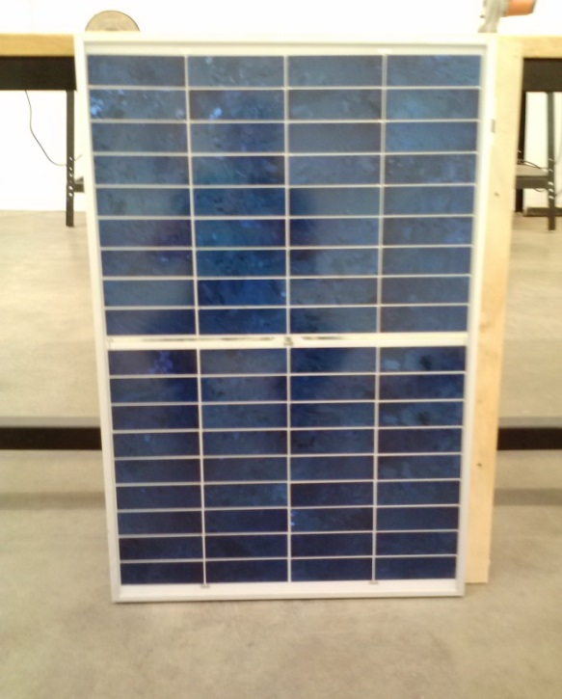
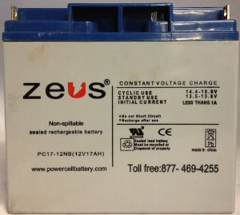
The Solar Panel Produces 50 W of Power and Outputs 16.5 V DC
Rate for power is $.105 per kWh
With an average of 12.16 hours of sunlight it takes 104 days to break even with our $600 budget.

